Slide 1

ENCRYPTION AND DECRYPTION USING MAYAN NUMERATION SYSTEM
Guided by: Dr.Shishir.K.Shandilya
Adil.M.Khokhawala 18BCY10007
Aakash. Vats 18BCY10002
Devyani.Senwar 18BCY10031
Tanishka.Rastogi 18BCY10106

Slide 2
INTRODUCTION
Our application gives the end user a new script to encrypt their confidential or important data to a form that will look alike binary numeration , but will not be binary. Notably our application focuses on securing data in a manner that if the decrypted text is leaked , it will be impossible to decode it back to the orginal text or file.

Slide 3
ABSTRACT IDEA
This project comes up with encryption and decryption in another method. The method used in this system is an ancient script of the early BC, known as MAYAN SCRIPTING. Our project will give the user a secure interface for both encryption and decryption of his/her data.

Slide 4
MODULES & METHODOLOGY
In this encryption and decryption application we encrypt the data in a way that the cipher text is produced in binary numeration.
Whereas in decryption we ask the user for the cipher text input along with a key which leads him/her to the initial data that was fed in the application.
For the key that enables encryption and decryption ,our method does not follow the conventional ways , rather we built our own method for generating the key.

Slide 5
HARDWARE AND SOFTWARE REQUIREMENTS
Laptop with minimum 4GB RAM.
C++
Python
Dev C++ / PyCharm

Slide 6
PROBABLE APPLICATION AREAS
Our encryption and decryption system can be used by various security systems which enable encryption of text as not everyone knows the idea of MAYAN script.
Notably, if they are not familiar with mayan script , it would be impossible to get a message from a bunch of 0’s and 1’s unless the attacker knows the key concept we have used.
It can be used for communicating messages securely without any possibility of loss of data.

Slide 7
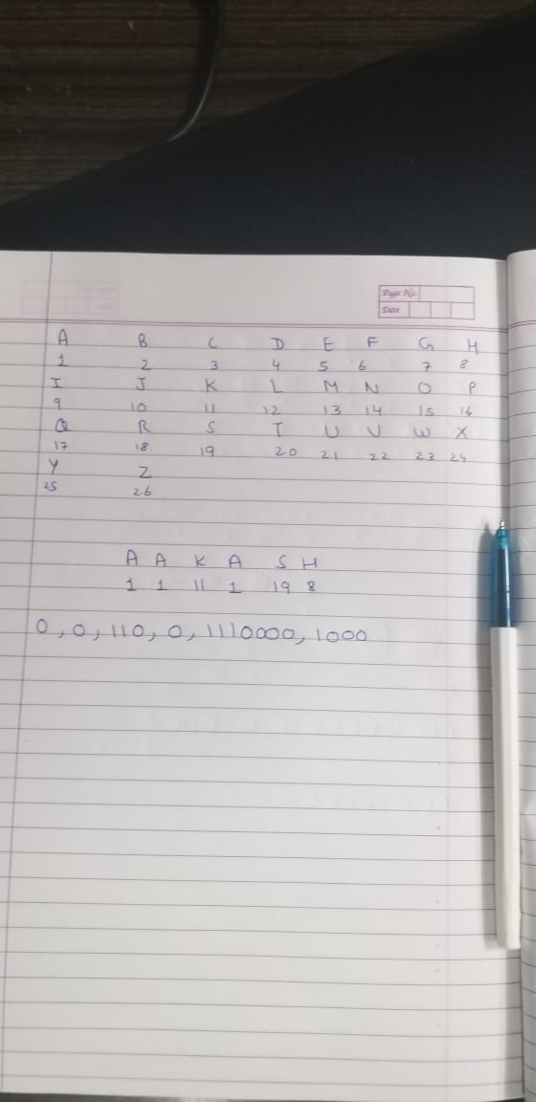
LOGIC

Slide 8
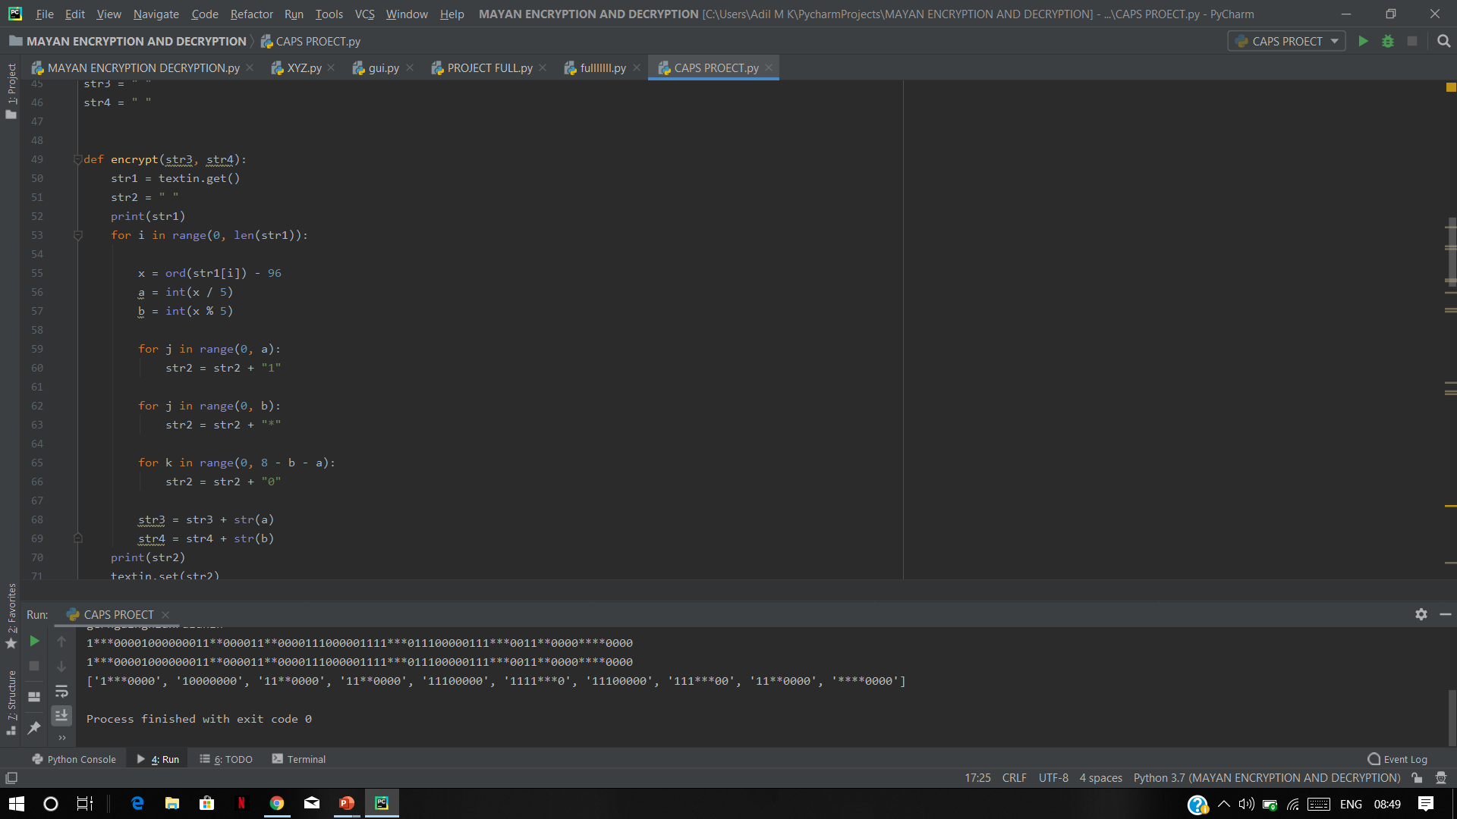
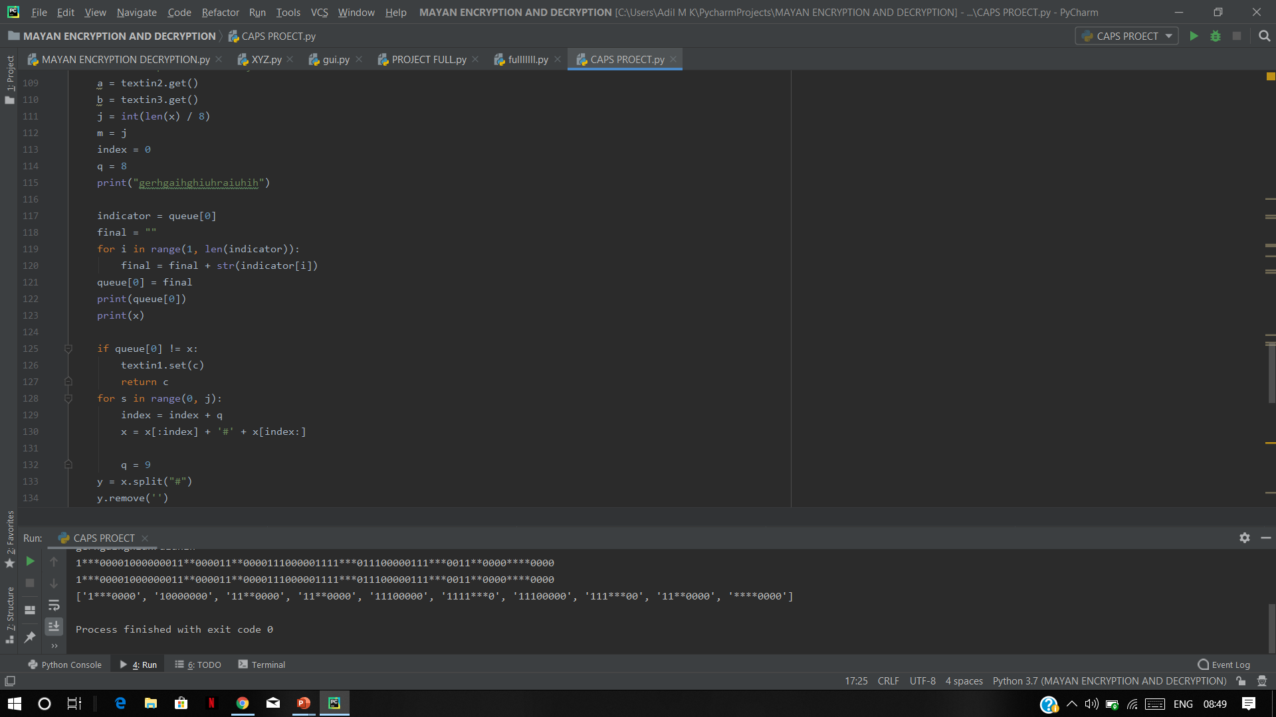
GLIMPSE OF CODE

Slide 9
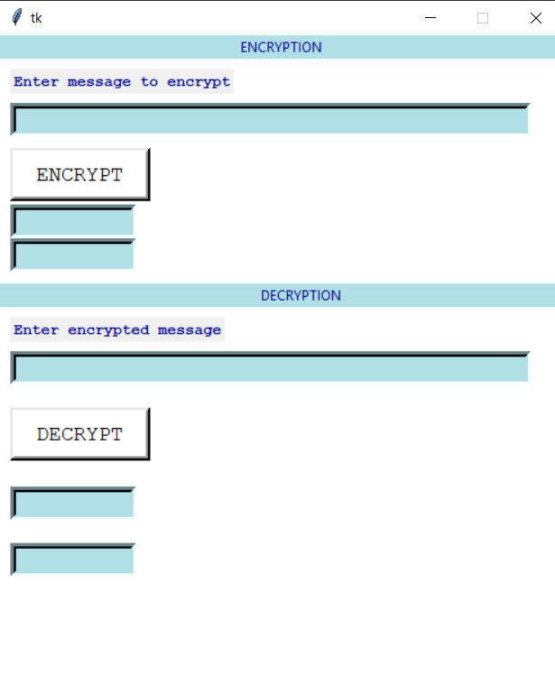
FINAL OUTPUT AFTER CODING

Slide 10


ENCRYPTION

Slide 11
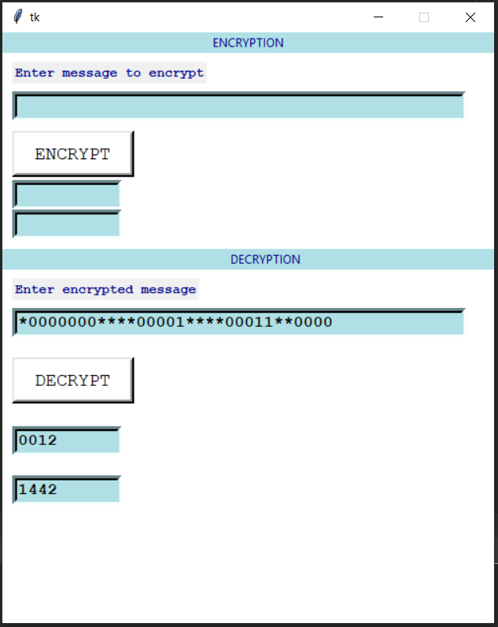

DECRYPTION

Slide 12
RESULTS & CONCLUSIONS
Our project thus successfully encrypts and decrypts the given data/text with the help of cipher text and respective key.
After encryption, the text will not be decodable without the unique key , therefore keeping it private for the owner and making it secure.
Hence our security system is highly difficult to crack and maintains the security and privacy of data.

Slide 13
PROJECT TIMELINE
Last week of August – Idea proposed and discussed with our guide.
1st week of September- Work started
2nd week of October –Functional program with entitled key.
4TH week of October- Entire program with GUI
1st week of November- Work complete, ready for exhibition!

Slide 14
THANK YOU!

Slide 15
REFERENCES
History of Mathematics by : DAVID.M BURTON
https://www.dcode.fr/mayan-numbers

